Slide 1
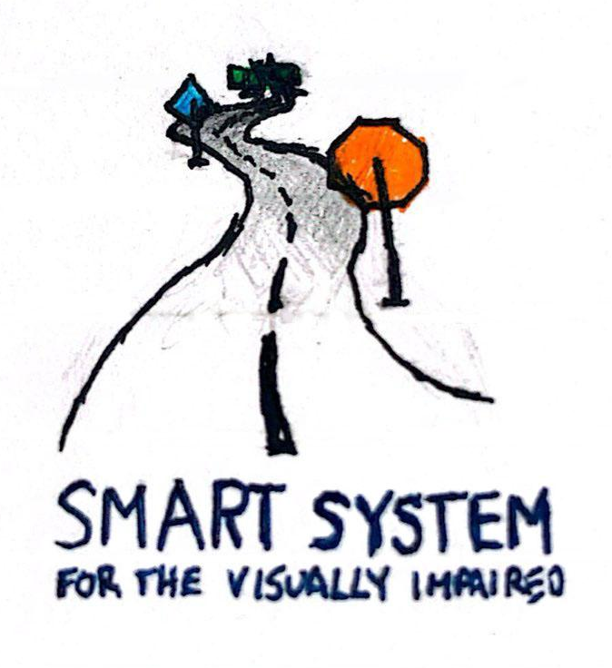
Smart System for Visually Impaired
Smart System for Visually Impaired
Lukas Chin, Jake Lee, Shamir Legaspi, David Li, Jason Li

Slide 2
Introduction

Slide 3
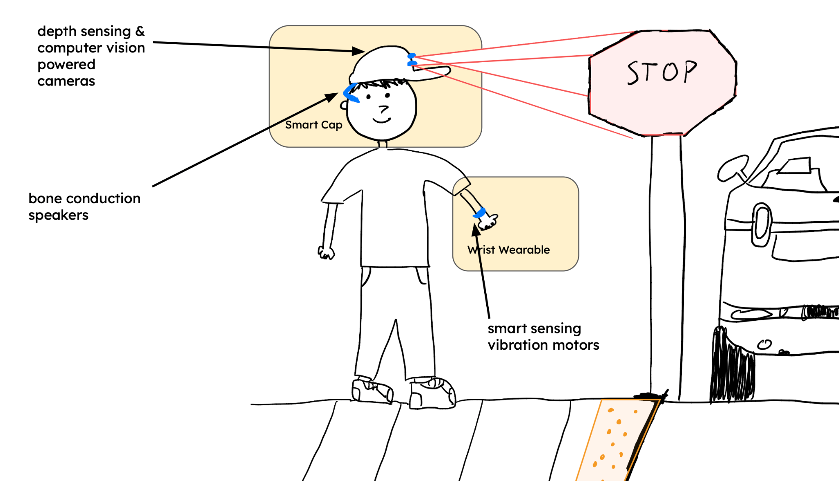
Introduction

Slide 4
Problem Statement

Slide 5
Problem Statement
• Visually impaired individuals benefit from navigational assistance.
• White canes and guide dogs have significant limitations.
• Current solutions inadequately translate environmental information.
• Society requires accessible solutions.

Slide 6
Requirements

Slide 7
Requirements/Deliverables
Required Functions
• Transmit haptic signals through vibration motors
• Stream and process video inputs
• Text-to-speech output
• Real-time feedback (<1s)
• Lightweight and comfortable for extended wear (<1lb)
• Battery life: 12+ hours per charge
• Easy to use with minimal training required
• Multi-environment operation (<10% accuracy difference between different environments e.g. indoors and outdoors)
Deliverables
• Wrist wearable that transmits differentiable haptic signals based on surroundings.
• Smart cap that gives an audio description of surroundings based on objects detected, object distances, and user queries.

Slide 8
Block Diagram

Slide 9


Raspberry Pi Camera Module
Raspberry Pi Camera Module
Microphone
Intelligent Visibility System
Photoresistor
Feeding live video stream
Human speech input
Raspberry Pi 5
Light Emitting Diode Array
Depth Map Processing
Variable Vibration Motors
Object Inquiry Assistant
Bone conduction speakers
ESP32 Microcontroller
Text-to-Speech
Wrist Wearable
Smart Cap
Smart System for Visually Impaired

Slide 10
Technology/Design

Slide 11
Object Detection
Object Detection Model: Implemented YOLOv3, pre-trained on the COCO dataset, via the OpenCV library to recognize common objects.
Hardware Setup: Utilized a Raspberry Pi Zero W with a Pi Camera Module to capture video streams, transmitted to an OpenCV server over a TCP connection for processing.
System Functionality: The server performs object detection on the video stream and integrates a text-to-speech library (pyttsx3) to announce identified objects in the frame.

Slide 12
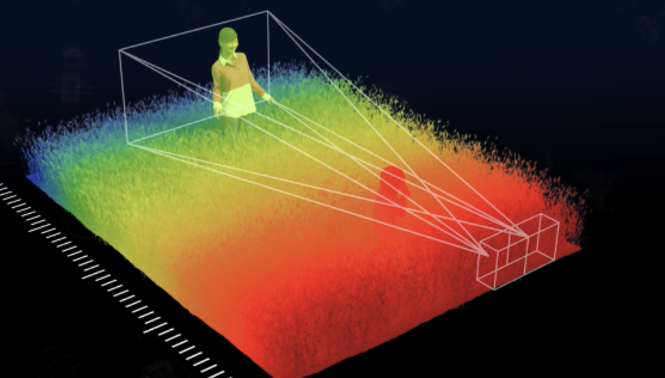
Depth Mapping and Distance Calculation
Utilizing 2 Raspberry Pi camera modules, the Smart Cap can accurate sense depth of field.
Depth Mapping can be to calculate distance of nearby and far obstacles for everyday walking.
Smart Cap can provide haptic feedback even more reliably to the user with 2 Raspberry Pi camera inputs versus 1 camera (no depth mapping).

Slide 13

Whisper.cpp
Through a microphone on the Smart Cap, users can record a query that is processed into a format consumable by Whisper.cpp.
The Smart Cap can then run the Whisper.cpp process with the audio of the recorded query as input to output text.
Through this speech-to-text system, users will be able to speak to make queries that are turned into text that modifies the output of the Object Inquiry Assistant.

Slide 14
Object Inquiry Assistant
Inputs:
Depth map processing and OpenCV information from Pi Camera live-stream
User speech-to-text from microphone using whisper.cpp
Outputs:
Text-to-speech into bone conduction speakers
Vibration motors on the wrist wearable

Slide 15
Wrist Wearable
Inputs:
Wireless data stream from Smart Cap visual feedback
Outdoor illumination detection from photoresistor
Outputs:
Variable vibration motors for haptic feedback and user notification
High-visibility LED for user safety and convenience

Slide 16
Prototype Results

Slide 17
Prototype Results
Tasks | Successful? (Y/N)
Raspberry Pi and TinyPico are connected to router’s network | Y
Raspberry Pi’s camera module’s live stream can be observed on user’s computer | Y
TinyPico successfully sends request and receives responses | Y
TinyPico’s received responses trigger “notifications” which prompt vibration motors to turn on | Y
Computer vision Python script through user’s computer’s webcam successfully detects objects and reports accuracy of detection | Y
Able to communicate audibly to the user the detected objects | Y
User is able to sense a vibration when a target object is in frame | Y
User feedback in under 1 second | N

Slide 18
Schedule

Slide 19
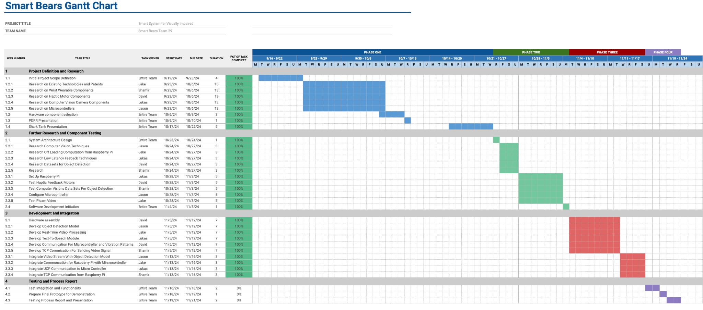
Gantt Chart

Slide 20
What’s Next?
Hardware Optimization: Design and develop lightweight, ergonomic housing design for our system’s wrist-wearable and smart cap
Communication Enhancement: Optimize Raspberry Pi and microcontroller integration
Real-Time Performance: Enhance feedback mechanisms
Improve livestream quality and reduce delay
Optimize alert delivery system
Implement more responsive user notifications

Slide 21
Thank You! + Questions?

